Slide 1
Designing Application Protocols for TCP/IP
Stephen Cleary
Notes:
[0:00 - 3:00]
Feel free to ask questions during this presentation.

Slide 2
Who is Stephen Cleary?
Jervis B. Webb: AGVs, printing presses, hot backup systems, smart clients; many “bridge” devices to translate TCP/IP to/from serial or unusual networks.
Salamander: Safety monitors for firemen (Delphi).
Microline: Pipeline inspection tools (embedded).
Clients: GM (auto assembly lines), Syracuse News (paper delivery), Estee Lauder, RR Donnelley (bottling), Ricoh (toner), BlueScope Steel. (all 24x7).
Notes:
[3:00 - 6:00]
“AGV” (Automatic Guided Vehicle)
Most socket class wrappers are buggy in the edge cases. You should prefer to use WinSock directly.
I’ve found (and fixed) bugs in the VCL socket classes, and identified bugs in the MFC socket classes. I wrote my own C++ socket classes years ago (proprietary).
This talk is a “brain dump” of key lessons I’ve learned over the years of designing (and fixing!) custom application protocols.

Slide 3
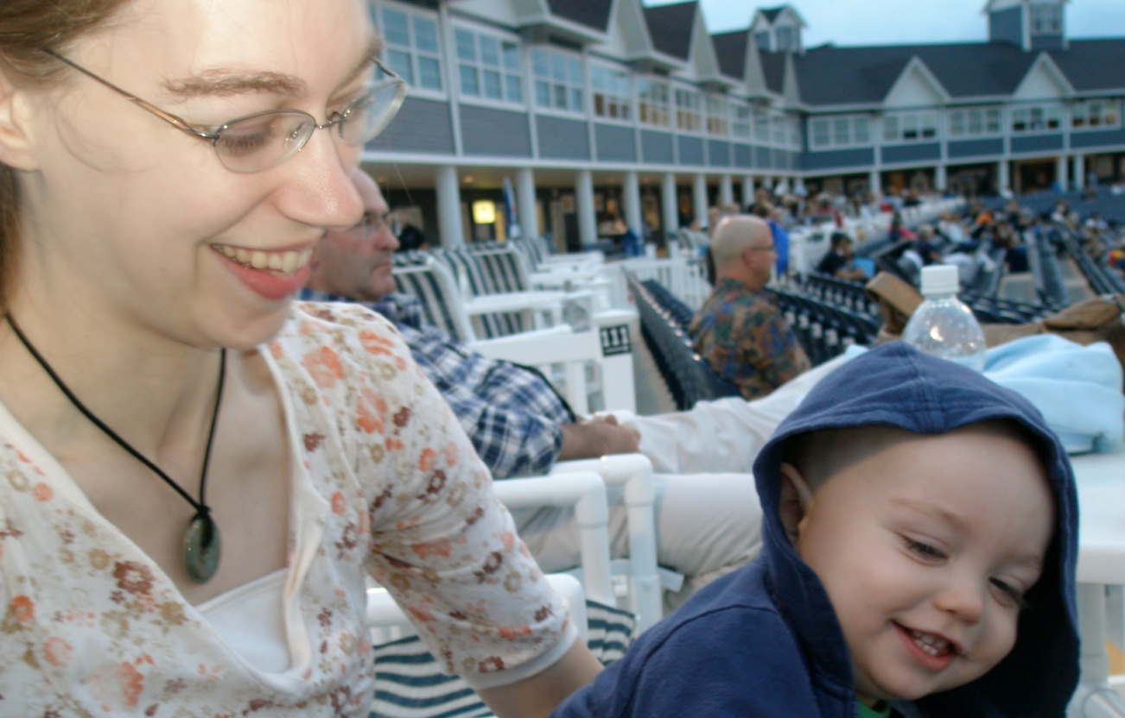
Sponsors
Jesus Christ.
Amanda and SD Cleary.
Notes:
[6:00 - 9:00]
Jesus Christ is my primary Sponsor.
Everyone has sinned (done something wrong), and the penalty for that sin is Hell.
Jesus Christ paid the penalty for our sins when He died, so we do not have to go to Hell.
If we repent of our sins and receive Jesus Christ, He will take us to Heaven when we die.
More information is available; any questions about the Bible or Christianity are welcome. (I do have a Bachelor’s in Biblical Studies).

Slide 4
What is an “Application Protocol”?
An application protocol is all the communication above the TCP/IP layer.
Examples: HTTP, FTP, POP, SOAP/HTTP.
We won’t cover: UDP, implementation specifics (e.g., optimal error recovery for the WinSock API).
For C# implementation specifics, my blog has a TCP/IP .NET Sockets FAQ.
Notes:
[9:00 - 12:00]
Generic solutions do exist (e.g., SOAP/HTTP), but they are inefficient and difficult to implement (without good library support). For this reason, custom application protocol design is still alive and well: programs (especially devices) choose to define their own protocols.

Slide 5
What TCP/IP Provides
Affects the application protocol design:
Concept of a “Connection” (client connects to server, after which the two sides are identical).
Reliability: acknowledgements, checksums, retransmission, discarding duplicate packets.
Sequencing: packets are sorted on receipt to match original sending order.
Does not affect the application protocol design:
Flow and congestion control, adaptive timeouts, other stuff: Nagle algorithm, delayed ACKs, etc.
Notes:
[12:00 - 15:00]
Note: Don’t disable Nagle! It’s almost always a mistake.
This is a description of what TCP/IP provides. The key to correct TCP/IP Application Protocol Design is knowing two important things that TCP/IP doesn’t provide!

Slide 6
Types of App Protocols
Stream-based: data is streamed across the connection, e.g., audio or video transmission.
Message-based: based on exchanging messages.
Request/Response: one side initiates with a Request; the other side replies with a Response.
Poll/Status: most communication is a Poll request and a Status response.
Subscribe/Event: one side subscribes to event notification with a Subscribe message; the other side sends Event messages whenever the event occurs.
Notes:
[15:00 - 18:00]
These are not mutually exclusive (a single application protocol may be partly Request/Response and partly Subscribe/Event); these are common patterns found in application protocols.

Slide 7
Specification Basics
Having a clearly-defined specification written down will reduce errors on both sides.
Terminology:
“MUST” and “MAY” (RFC 2119).
Include a glossary referencing established standards.
First Contact: decide who is client and who is server.
Choosing the Port (configurable if possible):
IANA: 0-1023 is off limits; 1024-49151 is “off limits”.
Preventing ephemeral conflicts: KB812873
Notes:
[18:00 - 21:00]
Kind of funny, but my first point is essentially: “write it down!”
“Terminology – MUST” RFC 2119 provides definitions for “MUST”, “MAY”, “SHOULD”, etc., to unambiguously describe what is required and what is optional.
“Terminology – Include” e.g., The Unicode standard has specific definitions for “character”, “code point”, and “encoding”.
How pedantic you are is up to you. I lean towards using very accurate terms.
“First Contact” After the connection is established, both sides look the same. However, to establish the connection, a client must connect to a server. If you have a 1-to-many scenario, then the “1” side is the server (obviously). If you have a 1-to-1 scenario, then one side must be chosen as a server – sometimes it’s more natural to think of one side as a server, but other times it’s just a tossup. Peer-to-peer (many-to-many) scenarios often have all participants acting as both client and server.
Either way, explicitly state which side is the server in the spec.
“Choosing – IANA” (Internet Assigned Numbers Authority) No one listens to their “1024-49151” reservation, hence the quotes.
“Choosing – Preventing” Ephemeral (e-fe-mê-rêl; e=egg, ê=but) ports are those chosen by the OS, usually for client sockets.
Windows systems use 1025 to 5000 by default, but the upper value may be changed via the registry. Linux and other OSes have different ranges.
KB812873 details the ReservedPorts registry key, which specifies ports that Windows won’t use as ephemeral ports.

Slide 8
App Protocol Versioning
Plan for the future now: enable future backwards compatibility. It’s easier now than later!
Application protocol documents should always have a version number defined in the document.
The version of the app protocol used at runtime should be negotiated, not assumed.
Don’t over-engineer! A simple implementation is to send a list of supported versions, and let the other side choose. Negotiating feature sets is more complex.
Decide in advance which version number changes are backwards-compatible and which are not.
http://nitoprograms.blogspot.com
Notes:
[21:00 - 24:00]
Allows partial updates to newer versions (one side, then the other).

Slide 9
Message Framing
TCP does not preserve message boundaries (!)
From the app’s perspective, TCP does not operate on packets of data; it operates on streams of data.
“Send” places bytes in the outgoing stream; “Receive” reads bytes from the incoming stream.
Send and Receive are not 1:1
“Receive” was designed to allow partial reads.
A
Stream from A to B
B
Stream from B to A
http://nitoprograms.blogspot.com
Notes:
[24:00 - 27:00]
“TCP does” TCP/IP does provide Reliability and Sequencing, but this does not provide message boundaries.
“From the” The abstraction of TCP/IP is a stream; it is a stream protocol.
“’Send’ places bytes” Do not assume that a single Send will result in a single Receive. This is the most common mistake for “newbie” TCP/IP application protocol designers.
One side may send 5 bytes, then send 5 more bytes. This places 10 bytes in the outgoing stream. The receiving side may call Receive 10 times if it’s only reading one byte at a time, or it may decide to wait a bit and read all 10 bytes at once.
Unnecessary Detail: TCP/IP’s Reliability and Sequencing does preserve packets (splitting them up as necessary, and re-assembling and re-ordering them on the receiving side). [Technically, TCP preserves segments, which may contain multiple packets, but does not preserve messages].
[The abstraction exposed by the network layer is packet-based; the abstraction exposed by the TCP layer is stream-based].
TCP/IP documentation is misleading, talking about splitting and reassembling segments. Loopback testing confirms this misunderstanding. This error is often not detected until the project goes live, with longer delays between client and server.
True story: I once worked for a company that developed custom client/server software. The original communications code had made this common mistake. However, they were all on dedicated networks with high-end hardware, so the underlying problem only happened very rarely. When it did, the operators would just chalk it up to "that buggy Windows OS" or "another network glitch" and reboot. One of my tasks at this company was to change the communication to include a lot more information; of course, this caused the problem to manifest regularly, and the entire application protocol had to be changed to fix it. The truly amazing thing is that this software had been used in countless 24x7 automation systems for 20 years; it was fundamentally broken and no one noticed.

Slide 10
Message Framing
Most protocols are based on messages (e.g., query / response), so we need message framing.
Solution A: Length Prefixing
Specify length and endianness of length prefix.
(May be hidden as a “message ID” if message lengths are known, and may be at a fixed offset instead of a prefix.)
Solution B: Delimiters
Escape sequences may be necessary.
Requires flexible buffer scheme to receive efficiently.
Both solutions must consider DoS protection.
http://nitoprograms.blogspot.com
Notes:
[27:00 - 30:00]
TCP does not operate on packets of data; it operates on streams of data.
“Most protocols” – Exception: Streaming protocols.
Mixed solutions are also possible, e.g., HTTP uses delimiters for its headers, one of which is Content-Length, which acts as a length prefix for the content.
My personal favorite: 4-byte unsigned little-endian length prefix.

Slide 11
Keepalives
TCP does not provide detection of dropped connections. It is an idle protocol.
TCP will detect a dropped connection if data is sent. The receiving side will not get a notification; this results in a half-open connection.
Causes: router/computer crash, wireless lost.
Wrong solutions: ping or a second connection.
Correct solutions: a timer sending an empty message frame or actual keepalive message. Or TCP option.
Keepalives must be done on both sides unless polling.
http://nitoprograms.blogspot.com
Notes:
[30:00 - 33:00]
“TCP does” The idleness of TCP/IP is for reliability and efficiency reasons. (It can gracefully continue a connection if an intermediate router is rebooted).
“TCP will” At any given point in time in most protocols, one side is sending a message and the other side is waiting for it.
“Correct solutions” I prefer empty message frames. The TCP option is problematic.
Unnecessary detail:
TCP keepalive option: on some OSes, they only have one system-wide timeout value on the order of hours; WinSock and Linux allow setting it per-connection. Embedded stacks may not support the option at all (and routers are not required to honor TCP keepalives either).
Rarely seen in test environments but common in the real world.
True Story: I once had to write software to control a serial device that operated through a "bridge" device that exposed the serial port over TCP/IP. The company that developed the bridge implemented a simple protocol: they listened for a single TCP/IP connection (from anywhere), and - once the connection was established - sent any data received from the TCP/IP connection to the serial port, and any data received from the serial port to the TCP/IP connection. Of course, they only allowed one TCP/IP connection (otherwise, there could be contention over the serial port), so other connections were refused as long as there was an established connection.
The problem? No keepalives. If the bridge ever ended up in a half-open situation, it would never recover; any connection requests would be rejected because the bridge would believe the original connection was still active. The bridge failed during our prototyping; when we brought the root cause to the other company's attention, they were unable to implement a keepalive (the embedded TCP/IP stack didn't support it), so they worked with us in developing a method of remotely resetting the bridge.
It's important to note that we did have keepalive testing on our side of the connection (via a timer), but this was insufficient. It is necessary to have keepalive testing on both sides of the connection.

Slide 12
Miscellaneous Notes
Put plenty of good examples in the protocol specification document to reduce ambiguity.
Implementation:
There is nothing more important than logging.
Have a full tracing system that can be turned on at runtime on production machines. You’ll need it.
Dump every byte received and sent, as well as its interpretation.
When in doubt, error out. Connections can always be re-established.
http://nitoprograms.blogspot.com
Notes:
[33:00 - 36:00]

Slide 13
XML over TCP/IP
Be familiar with the XML standard: www.w3.org.
Most protocols don’t use: entities (except for escaping), processing instructions, XSDs/DTDs, namespaces; some don’t use text (just elements and attributes).
Message framing is highly recommended.
Keepalives are required, as any other protocol.
Protocol versioning is highly recommended. XSDs/DTDs may interfere with compatibility.
A common rule: ignore unknown elements and attributes, instead of treating them as errors.
http://nitoprograms.blogspot.com
Notes:
[36:00 – 39:00]
The phrase "XML over TCP/IP" makes a good executive summary, but is insufficient for an application protocol specification.
“Most protocols” XML used for communication is well-formed but not valid.

Slide 14
XML over TCP/IP – Encoding
Each message becomes an XML document.
XML documents are sequences of Unicode characters; TCP works on sequences (streams) of bytes. The Encoding is what translates one to the other.
Three encoding decisions:
Encoding to use: specify or auto-detect.
Byte Order Mark: required by UTF-16; optional for UTF-8.
XML Prolog. May cause problems if encoding attribute is included (it’s easy to get wrong).
Do not perform an intermediate conversion to string.
http://nitoprograms.blogspot.com
Notes:
[39:00 - 42:00]
My favorite: UTF-8 without BOM or prolog.

Slide 15
XML over TCP/IP – Pipeline
Data Handling Overview
Log
Socket
Message Framer
Byte Stream
Byte Array
(Combine if possible)
Log
Encoding
Parser
Application
Unicode Chars
XML
http://nitoprograms.blogspot.com
Notes:
[42:00 - 45:00]
Sequence of Unicode chars; XML documents.
If possible, combine Encoding and Parsing to help reduce errors (if you do this, the XML is never treated as a string).
When reading backwards, Parser becomes Formatter.

Slide 16
XML over TCP/IP – Messages
For each element, be sure to include:
When the message is meaningful (e.g., a "Response" should only be sent in response to a "Request").
Which attributes and elements are required and which are optional. This includes complex relations (e.g., a "Log" element must contain at least one "Message" element and exactly one "Source" element). Be sure to use terms with specific definitions ("at least one", "exactly one", etc).
Document the format of any non-string data such as dates, booleans, and integers.
Messages are data and commands, not behavior.
http://nitoprograms.blogspot.com
Notes:
[45:00 - 48:00]
“Document the format”: Steal from printf [or String.Format] documentation.
“Messages are data”: Don’t over-engineer! Don’t allow the protocol to evolve into a remote object API (remote service is OK). SOAP has already been invented. ☺

Slide 17
XML over TCP/IP – Naming
Use PascalCasing for element/attribute names.
Two-letter acronyms are in all caps: IO; compound words are treated as a single word: Lifetime.
Avoid abbreviations, except Id and Ok.
Avoid language keywords: Event.
Prefer readability: MessageType, not TypeOfMessage.
Avoid “magic values”.
Attributes vs. child elements – be consistent.
http://nitoprograms.blogspot.com
Notes:
[48:00 - 51:00]
From Eric White’s Blog: http://blogs.msdn.com/ericwhite/archive/2009/08/12/xml-element-and-attribute-name-guidelines.aspx
“PascalCasing” – makes it easier to read XSLT (which uses lowercase with hyphens)

Slide 18
Socket class - Asynchronicity
Socket API three times over (synchronous, Begin/End async, and SocketAsyncEventArgs async).
void Disconnect(bool);
IAsyncResult BeginDisconnect(bool, AsyncCallback, object); void EndDisconnect(IAsyncResult);
bool DisconnectAsync(SocketAsyncEventArgs);
*Async methods are just a more efficient form of Begin/End, not the event-based asynchronous pattern.
Do not use synchronous methods.
http://nitoprograms.blogspot.com
Notes:
[51:00 - 54:00]
Overloads include “ref Socket” as well as various parameters (scatter/gather I/O, different endpoints for connecting).

Slide 19
Socket class - Operations
Bind (sync)
Listen (sync)
Accept
Connect
Send
Receive
Disconnect
Shutdown (sync)
Close (sometimes sync; always acts sync)
http://nitoprograms.blogspot.com
Notes:
[54:00 - 57:00]

Slide 20
Thank you!
Stephen Cleary
Notes:
[57:00 - 60:00]
I hope you learned something useful!
Questions?

